Slide 1

Python-Based Smart Medicine
Reminder and Refill Alert System
CSA0820 - Python Programming for Scientific Computing
UNDER THE GUIDANCE OF :
PRESENTED BY:
Dr. P. Vijayaragavan
Dr. Aruna
D. Hemasree (192524114)
G. Srividya (192524158)

Slide 2
Introduction
Background
Medication non-adherence is a major global health problem.
Millions of patients miss doses or forget to refill prescriptions.
This leads to preventable hospitalizations and worsening of chronic conditions.
Why Python?
Python has rich libraries — Tkinter, SQLite, schedule, smtplib, and Twilio.
It allows building a full-featured desktop application with less code.
Python connects easily with Arduino hardware using PySerial.
Project Vision
A Python system communicates with Arduino via PySerial in real time.
It detects medicine levels using IR sensors and triggers smart alerts.
Alerts are sent through desktop popup, email, and SMS automatically.

Slide 3
Problem Statement
Context
Key Statistics
Chronic disease patients need strict medicine schedules every day.
Manual tracking is unreliable, especially for elderly patients living alone.
50%
patients skip medicines
Problem
125K+
Patients frequently miss doses or run out of medicine without refill alerts.
Traditional pill boxes offer no automation or smart connectivity.
deaths/year (non-adherence)
30%
Why It Matters
fewer hospitalizations
Missed doses cause disease progression and expensive emergency visits.
Smart reminder systems reduce hospitalizations by up to 30%.
₹1.5L Cr
India's annual burden

Slide 4
Objectives
Python Desktop App
Refill Alert Module
Build a Tkinter GUI for managing medicine schedules and patient profiles using SQLite database.
Automatically detect low medicine levels using IR sensor data and notify caregivers in advance.
Smart Reminder System
Data Logging & Reports
Send time-based alerts using the schedule library — desktop popups, email (smtplib), and SMS (Twilio).
Track adherence history and generate compliance reports using Matplotlib stored in SQLite.
Arduino Integration
Real-Time Monitoring
Python communicates with Arduino via PySerial to receive real-time IR sensor data from compartments.
A Python background thread continuously monitors sensor readings and triggers alerts on missed doses.

Slide 5
Scope of the Project
Project Boundaries
This project focuses on Python desktop app development with Arduino hardware integration. It covers medicine scheduling, automated reminders, and refill detection — not a medical diagnosis tool.
What is Included
What is Excluded
Python GUI app (Tkinter) for medicine scheduling
Arduino–Python (PySerial) serial communication
IR sensor-based medicine compartment monitoring
Desktop, Email & SMS alert system
SQLite database for patient & medicine records
Medication adherence tracking & reports
RTC module integration for accurate timing
Medical diagnosis or prescription recommendations
Mobile app (Android/iOS) development
Cloud or IoT server deployment
Multi-patient hospital-level management
Wi-Fi or Bluetooth wireless connectivity
Automated medicine dispensing mechanism
Insurance or pharmacy system integration

Slide 6
Proposed Solution / Methodology
Technologies Used
1
Hardware Setup
Python 3.x
Tkinter GUI
PySerial
SQLite3
smtplib / Twilio
Matplotlib
Arduino IDE (C++)
The Arduino hardware is set up with IR sensors and an RTC module
2
PySerial Connection
Python connects to Arduino through a USB serial port using PySerial and reads sensor data in real time.
3
Python Processing
A Python background process checks the data against the medicine schedule stored in SQLite.
4
Alert & Notification
If a dose is missed, alerts are sent through desktop popup, email, and SMS.
5
Refill Detection
If the medicine compartment is detected empty, a refill alert is automatically triggered.

Slide 7
Literature Survey / Existing Systems
Existing 1: Manual Pill Boxes
Gaps in Current Solutions
Traditional weekly pill organizers require manual refilling with no electronic monitoring.
They offer zero automation and completely rely on patient memory.
Highly unreliable for elderly or cognitively impaired users.
No hardware-level detection
Cannot confirm dose taken
No refill prediction
High cost & cloud-dependent
Not suited for Indian context
Our Python system solves all!
Existing 2: Mobile Reminder Apps
Apps like Medisafe send push notifications but lack hardware integration.
They cannot detect whether medicine was actually taken — only if reminder was dismissed.
No refill detection capability is available.
Existing 3: Commercial Smart Dispensers
Products like Hero or MedMinder cost ₹15,000–₹50,000+ with monthly subscriptions.
They depend on cloud servers and are not affordable for common Indian households.
Not accessible in rural areas.

Slide 8
Module 1
Python Medicine Reminder System

Slide 9
Module 1: Python Medicine Reminder System
GUI – Tkinter Dashboard
reminder.py
Created a desktop application using Tkinter for patients to enter medicine name, timing, and dosage.
Patient details and medicine schedules are stored in a SQLite database for local data storage.
The patient does not need to perform any manual actions after setting the schedule.
import schedule, smtplib
import sqlite3
from plyer import notification
def send_reminder(medicine):
notification.notify(
Schedule Engine
title='Medicine Reminder'
The Python 'schedule' library runs in the background and continuously checks the medicine timings.
When the scheduled time matches, the system automatically triggers an alert.
The system automatically manages medicine reminders and notifications.
message=medicine)
def send_email(to, msg):
server = smtplib.SMTP_SSL(
'smtp.gmail.com', 465)
server.sendmail(to, msg)
# Schedule daily reminder
Alert Notification Engine
schedule.every().day.at('08:00').
A popup notification appears on the screen to remind the patient.
An email alert is sent using the smtplib library.
An SMS alert is sent using Twilio.
All three notifications (popup, email, and SMS) are triggered simultaneously.
do(send_reminder, 'Metformin')

Slide 10
Module 2
Arduino Hardware & Refill Alert System

Slide 11
Module 2: Arduino Hardware & Refill Alert System
Hardware Integration Module
serial_reader.py
Connected real hardware components to the Python application.
Placed IR sensors inside each medicine compartment of the box.
IR sensors detect whether medicine is present or not in the compartment.
If the compartment is empty, the sensor generates a signal.
The signal is sent to the Arduino Uno for processing.
import serial, json
import threading
def read_arduino():
ser = serial.Serial(
Arduino–Python Communication Module
'COM3', 9600)
while True:
Arduino Uno converts the sensor signal into data.
The data is sent to Python through a USB cable using PySerial.
Python continuously reads the incoming data in the background using a thread.
line = ser.readline()
data = json.loads(line)
if data['slot1'] == 0:
Medicine Monitoring & Alert System
send_refill_alert()
If a dose is missed (medicine remains in the box after the scheduled time), Python sends an alert.
If the compartment becomes completely empty, Python sends a refill alert to the caregiver.
The LCD screen displays the medicine name and current status.
The buzzer provides an audible alert notification.
Green LED indicates medicine taken successfully.
Red LED indicates a missed dose.
Yellow LED indicates that a refill is required.
# Run in background thread
t = threading.Thread(
target=read_arduino)
t.daemon = True
t.start()

Slide 12
Tools and Technologies
Frontend (GUI)
Backend (Python)
Database
Tkinter — Python built-in GUI framework
ttk widgets for modern styling
Canvas for custom visual elements
PIL/Pillow for image display
Python 3.x — core language
schedule library for timed tasks
Threading for background processes
PySerial for Arduino communication
SQLite3 — built-in Python database
Stores patient & medicine records
Dose history & adherence logs
No external server required
Alert System
Hardware Stack
Dev Tools
plyer — cross-platform notifications
smtplib + SSL — email alerts
Twilio SDK — SMS notifications
PySerial → Arduino buzzer trigger
Arduino Uno + Arduino IDE (C++)
IR sensors + RTC DS3231
16×2 LCD + I2C module
Buzzer + LEDs + Push buttons
VS Code / Thonny IDE
Git for version control
Matplotlib for reports/graphs
Fritzing for circuit diagrams

Slide 13
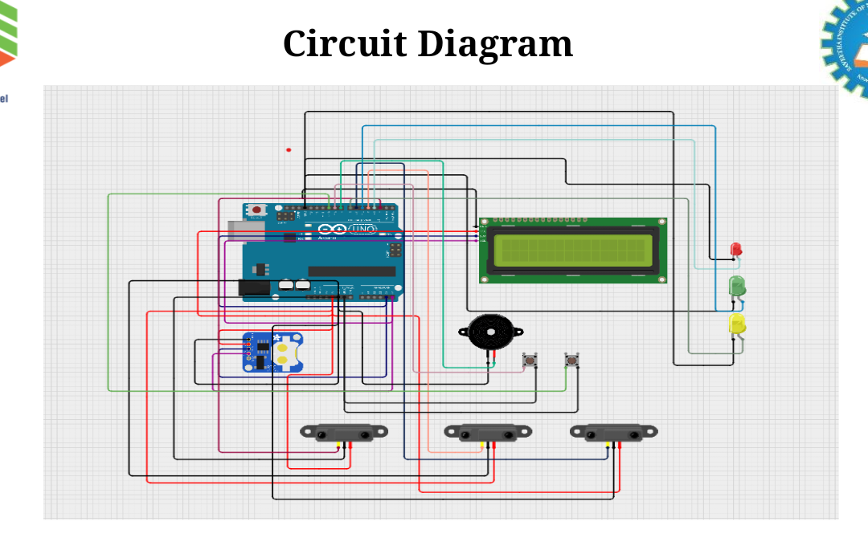
Working Model & Circuit Diagram
Working Model
Circuit Diagram
Components Used
Arduino Uno — main controller running C++ code.
IR Sensors (×3) — detect medicine presence per compartment.
RTC Module DS3231 — accurate real-time clock for timing.
16×2 LCD — shows medicine name and reminder status.
Buzzer + LEDs — audio and visual alerts for patient.
LCD Display
Arduino Uno
IR Sensors
Breadboard

Slide 14
Project Plan / Timeline
Phase 1
Phase 2
Phase 3
Phase 4
📅 06/2025
📅 07/2025 Week 1
📅 07/2025 Week 2
📅 07/2025 Week 3-4
Requirement Analysis
Hardware Design
Python Development
Integration & Testing
Define medicine reminder specs and sensor requirements.
Study Python libraries — PySerial, Tkinter, schedule.
Finalize module scope and system design.
Assemble Arduino circuit with IR sensors and RTC module.
Wire LCD display, buzzer, and LED indicators.
Test hardware components using Arduino IDE.
Build Tkinter GUI dashboard for patient use.
Implement SQLite database schema for records.
Code PySerial Arduino bridge and alert engine.
Integrate hardware with Python application.
Test reminder and refill alert workflows.
Debug edge cases and incorporate user feedback.

Slide 15
Expected Outcome
🎯 Final Deliverables
A fully functional Python desktop application integrated with Arduino hardware — capable of scheduling medicine reminders, detecting missed doses via IR sensors, sending multi-channel alerts (desktop, email, SMS), and automatically triggering refill notifications when medicine stock runs low.
Value to Users
Future Scope
Instant alerts on missed doses via desktop, email & SMS.
Hardware-confirmed medicine detection — not just reminders.
Refill alerts before stock runs out — no last-minute rush.
Adherence reports for doctor visits and treatment review.
Low-cost solution using Arduino + Python — no subscriptions.
Upgrade to Raspberry Pi for Wi-Fi and IoT
connectivity.
Android app integration via Bluetooth or REST API.
ML-based adherence prediction and behavior
analysis.
Multi-patient hospital ward monitoring system.
Cloud dashboard for remote caregiver access.

Slide 16
Conclusion
1
Built a low-cost embedded system that automates medicine reminders using RTC-based time scheduling.
2
Python bridges the gap between hardware sensing (Arduino) and intelligent software processing — providing an affordable healthcare companion.
3
IR sensor reliably detects medicine stock level and triggers a refill alert before the compartment runs empty.
4
LCD display, buzzer, and LED indicators give clear real-time feedback to the patient at dose time.
5
Push button lets the patient confirm a dose was taken, avoiding repeated false alerts.
6
Scalable architecture ready for IoT, mobile app, and cloud upgrades in the future.

Slide 17
References & Acknowledgements
📚 References
Python Software Foundation. (2024). Python 3.x Documentation. https://docs.python.org
Arduino. (2024). Arduino Uno Reference & PySerial Integration. https://www.arduino.cc
Osterberg, L. & Blaschke, T. (2005). Adherence to Medication. New England Journal of Medicine, 353(5), 487–497.
Twilio Inc. (2024). Twilio Python SDK Documentation. https://www.twilio.com/docs/python
SQLite Consortium. (2024). SQLite Documentation. https://www.sqlite.org/docs.html
Guide & Mentors
Institutional Support
We sincerely thank our project guide Dr. P. Vijayaragavan and Dr. Aruna for their continuous guidance, valuable feedback, and expert mentorship throughout this project.
We gratefully acknowledge Saveetha School of Engineering, SIMATS for providing the infrastructure, technical resources, and encouraging environment to complete this capstone project.

Slide 18
THANK YOU

